Slide 1
Digital Portfolio
STUDENT NAME: P Naveen Kumar
REGISTER NO AND NMID:
32324U09046/astvu32332324U09046
DEPARTMENT: BCA
COLLEGE: Voorhees College ,Thiruvalluvar University

Slide 2
Student Portfolio Website

Slide 3
Agenda
Problem Statement
Project Overview
End Users
Tools and Technologies
Portfolio design and Layout
Features and Functionality
Results and Screenshots
Conclusion
GitHub

Slide 4
Problem Statement
- Lack of professional platform for students to showcase skills
- Need for simple, responsive, and user-friendly portfolio

Slide 5
Project Overview
This project is a personal portfolio website designed to demonstrate web development skills. It provides sections for About Me, Skills, Projects, and Contact details. The design is responsive and visually engaging, making it suitable for both desktop and mobile users.

Slide 6
End Users
- Students
- Recruiters & HR Professionals
- Teachers & Mentors

Slide 7
Tools and Technologies
- HTML (Structure)
- CSS (Styling & Responsive Design)
- JavaScript (Interactivity)
- Git & GitHub (Version Control)

Slide 8
Portfolio Design & Layout
- Home: Hero section with intro
- About: Profile + Bio
- Skills: Grid of technical skills
- Projects: Showcase work
- Contact: Email & Phone

Slide 9
Features & Functionality
- Responsive navigation bar
- Interactive cards with hover effects
- Smooth scrolling
- Clean UI with modern color scheme

Slide 10
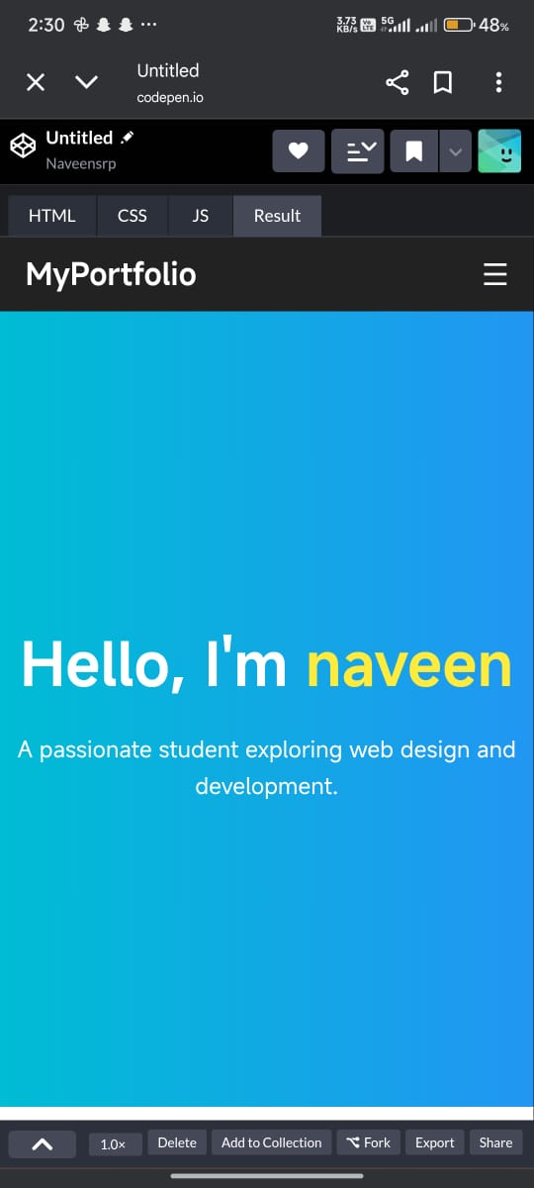
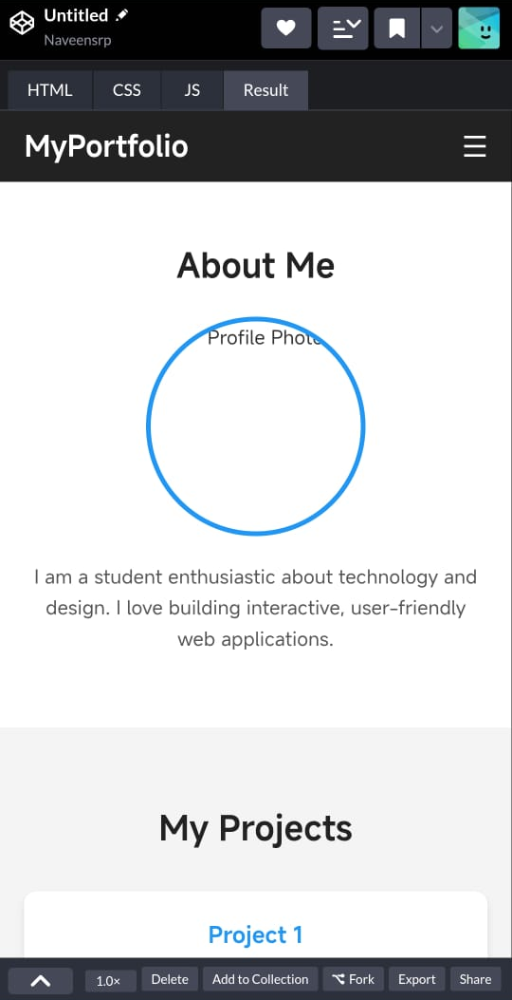
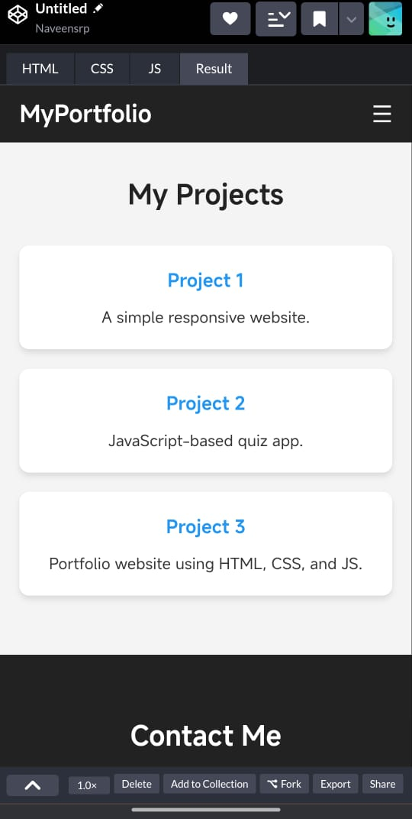
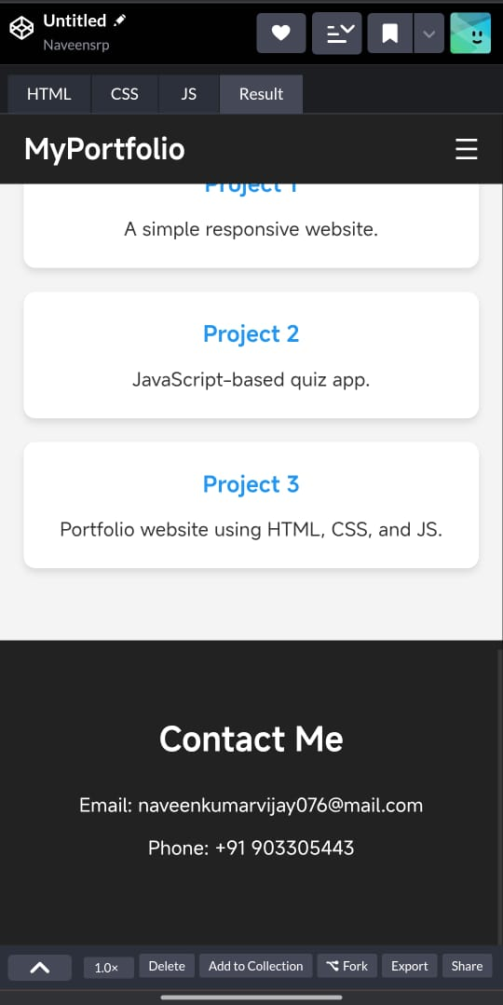
Results & Screenshots
Created a fully functional personal portfolio website

Slide 11
Conclusion
Provides personal brand identity
Helps in internships & placements
Can be scaled with more projects & skills

